Slide 1


Docker for Frontend Developer(Advanced)
Alejandro Del Rio Albrechet
1 DEC, 2016

Slide 2
What we know already
What is Docker
What is Docker image and container
What is Dockerfile
Basic docker commands
How to wrap our application into Docker container

Slide 3
Lets Run .net application
Go to orderApi folder and create docker image and run container
Now we have application up and running but it is quite tricky and to it we need
To run database container first and then run application.

Slide 4
Docker Compose
Compose is a tool for defining and running multi-container Docker applications.
Lets see what is inside go to compose folder

Slide 5
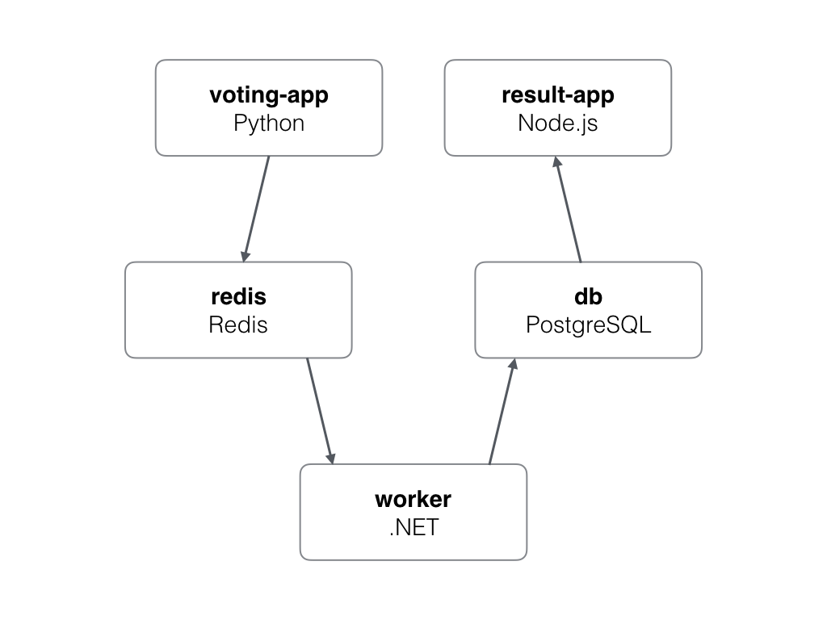
App Architecture

Slide 6
App logic
Python webapp which lets you vote between two options
Redis queue which collects new votes
.NET worker which consumes votes and stores them in…
Postgres database backed by a Docker volume
Node.js webapp which shows the results of the voting in real time

Slide 7

Discussion

